Slide 1
Overall system blow up CAD drawing
Annotate everything well in chamber
Use heating element model
Annotated diagrams/images for each claim point in application
By April 25th

Slide 2
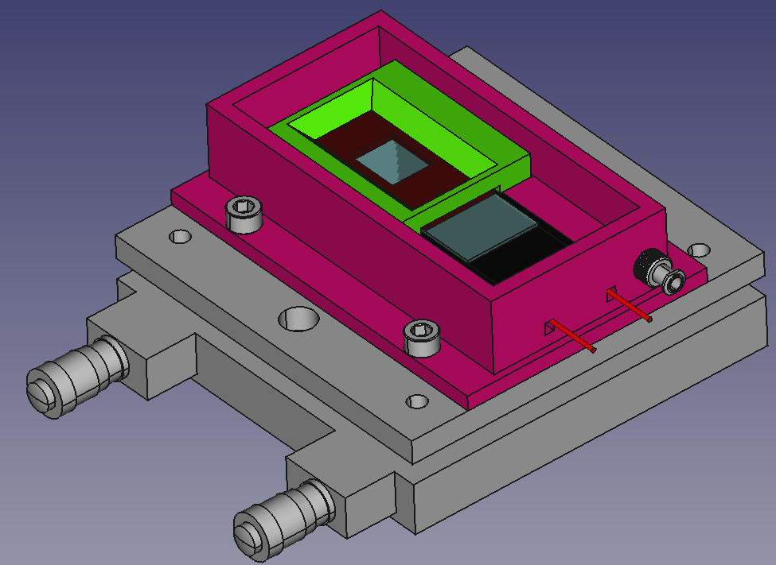

Slide 3
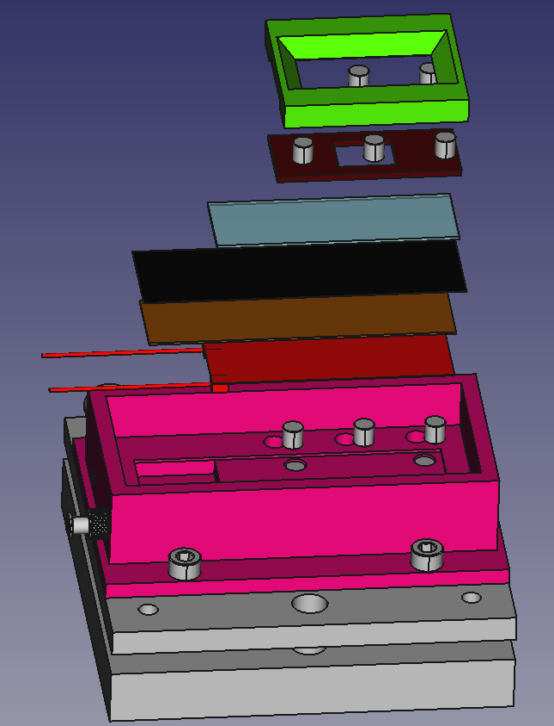
Pressure Plate
Pressure Plate Embedded Magnets
Invisi-Slip Fluidic Device
Glass Slide
Maxi-Black Antireflective Material
Hard Setting Potting Compound
PTC Heating Element with Wires
Pressure Plate Chamber Mount Magnetics
Fluidic Device Stabilization Magnets
PLA 3D printed Chamber
M6 Mounting Machine Screws
Tilt Stage

